Slide 1
Disaster response

Slide 2
Major Points to discuss
Definition
Disaster response planning
Stage 1: Strike teams and first 7 days
Stage 2: 7 to 30days
Stage 3: 30 days plus
Rebuild and long-term needs

Slide 3
Definition
Disaster response refers to the actions taken directly before, during or in the immediate aftermath of a disaster. The objective is to save lives, ensure health and safety and to meet the subsistence needs of the people affected.^{[1]: 16} This includes warning/evacuation, search and rescue, providing immediate assistance, assessing damage, continuing assistance and the immediate restoration or construction of infrastructure (i.e. provisional storm drains or diversion dams). The aim of emergency response is to provide immediate assistance to maintain life, improve health and support the morale of the affected population. Such assistance may range from providing specific but limited aid, such as assisting refugees with transport, temporary shelter, and food to establishing semi-permanent settlements in camps and other locations. It also may involve initial repairs to damage or diversion to infrastructure.

Slide 4
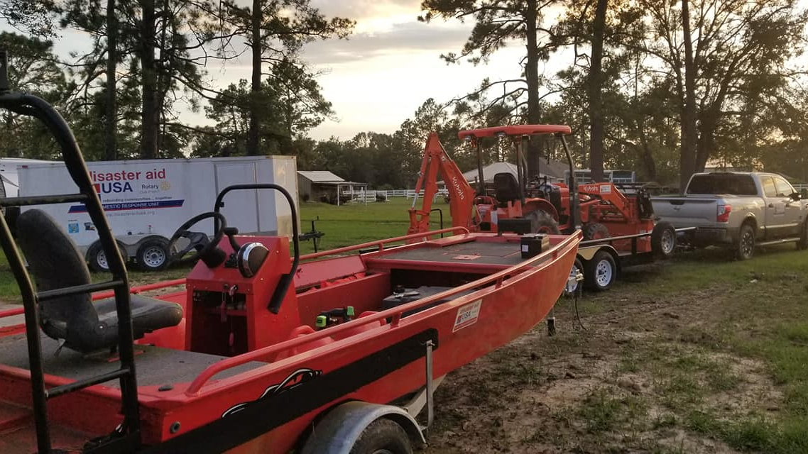
Disaster response planning

Slide 5
Disaster Committee
Chairman
Operations
Logistic
Finance
Liaison with VOAD & EOC

Slide 6
WHERE DO YOU START

Slide 7
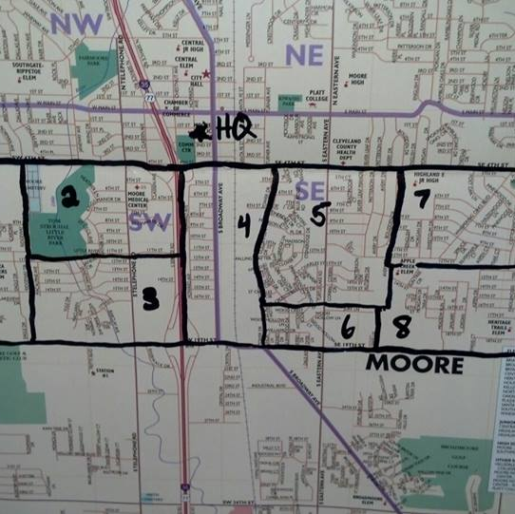
Break down your area into zones
Natural/Topographical
Neighborhoods
Rotary clubs
You decide what is best for your area & disaster

Slide 8
Rescue and response boat teams

Slide 9
Don’t forget to utilize the youth!

Slide 10
Coordinate with EOC and other Rescue Teams

Slide 11
Chainsaw and Equipment teams

Slide 12
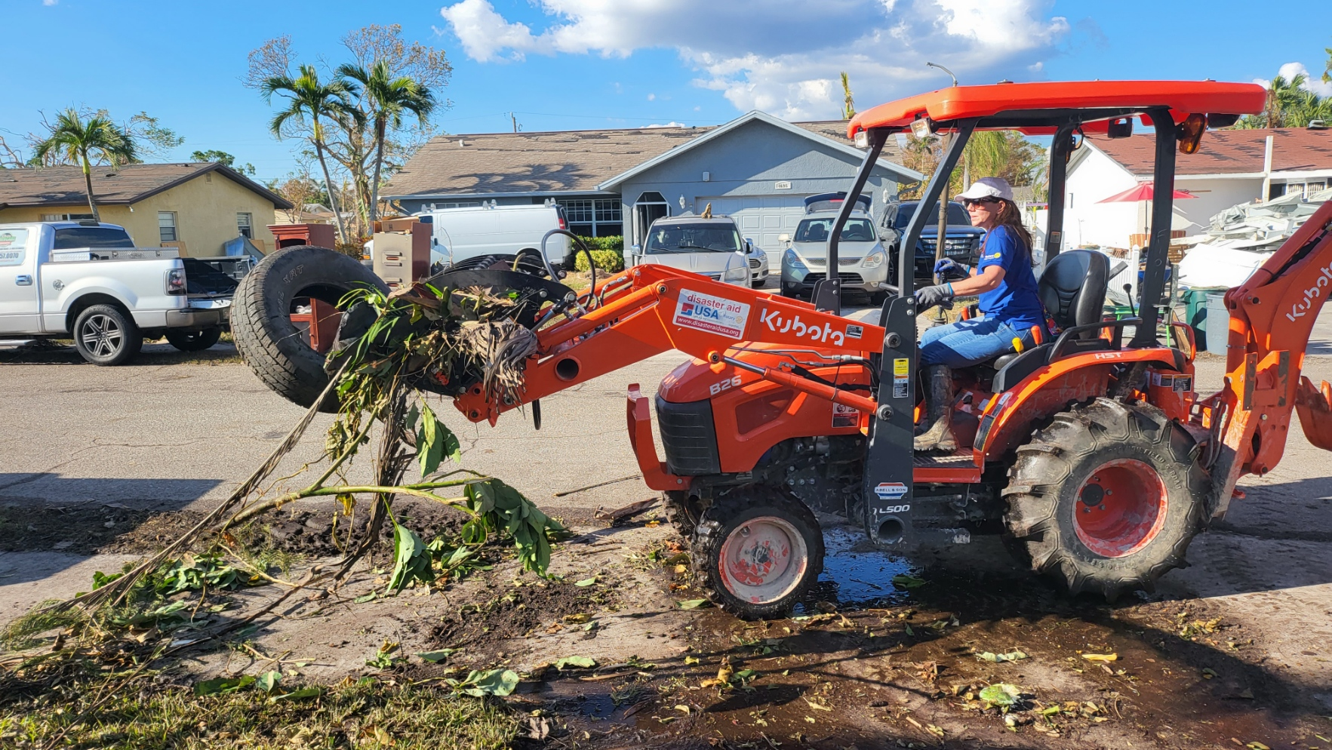

Slide 13
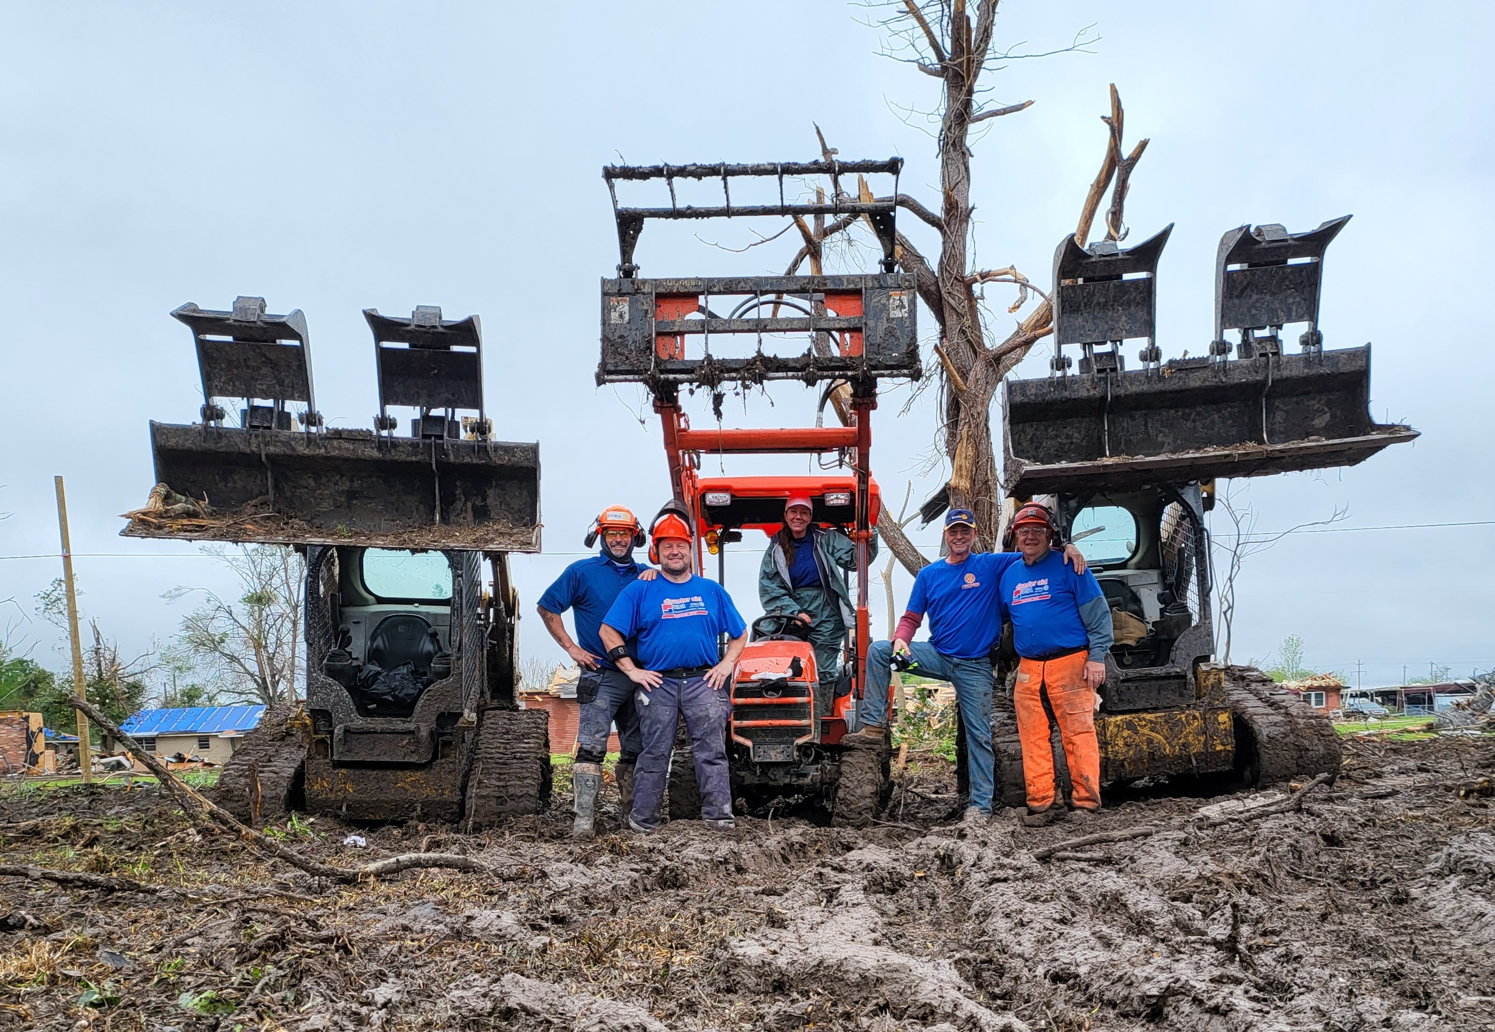

Slide 15
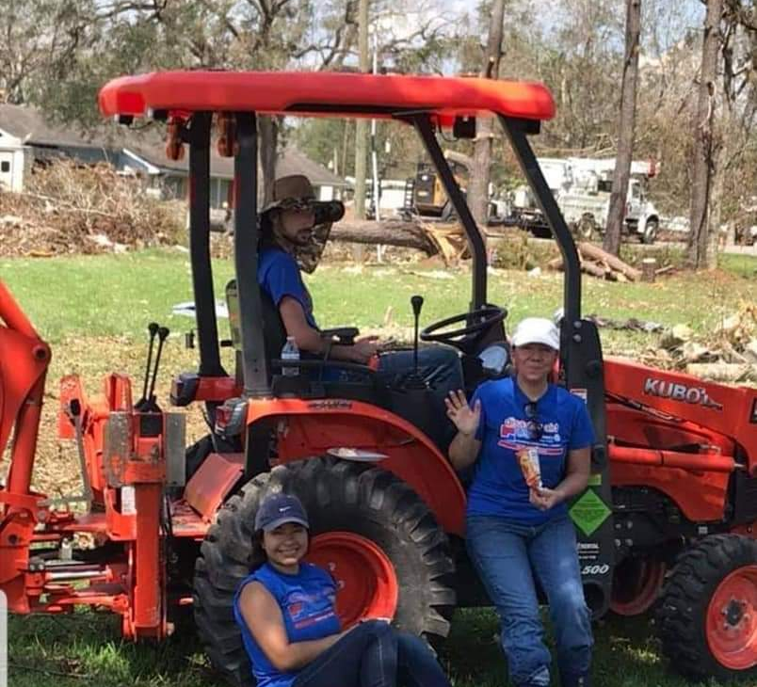
Make a family and friends event to help others

Slide 16
Muck and Gut teams a small phrase for a lot of work

Slide 18
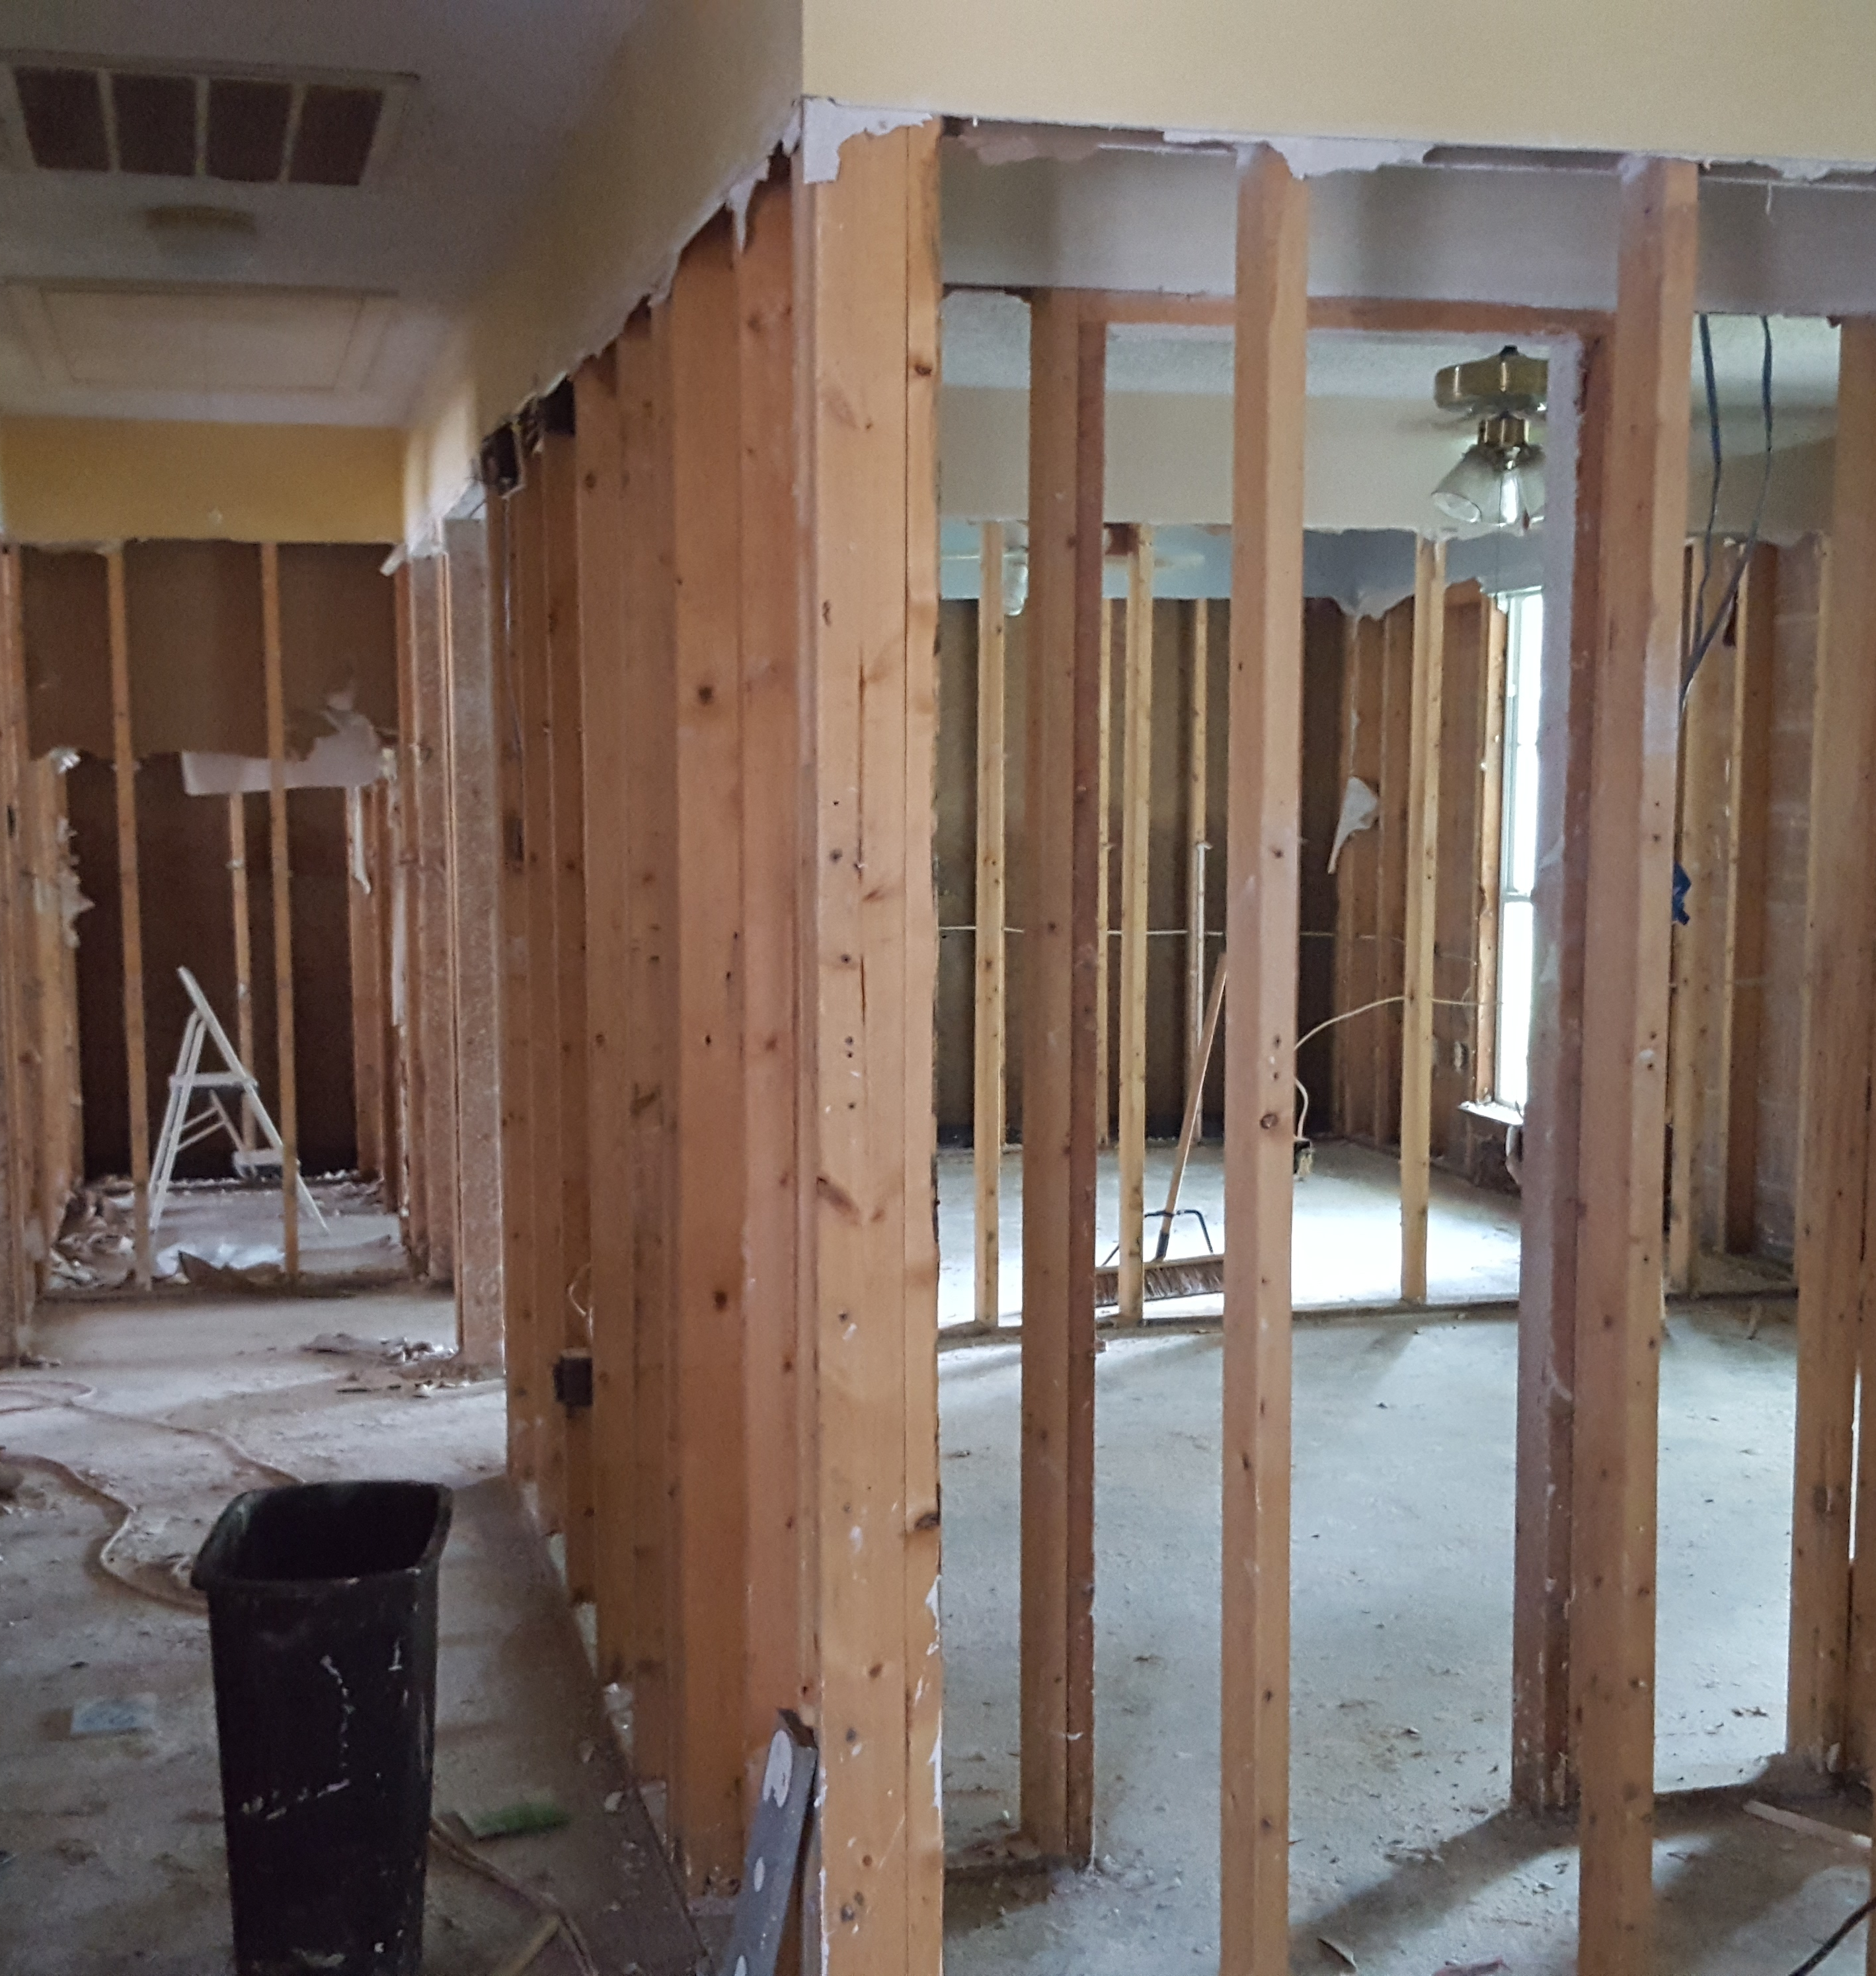
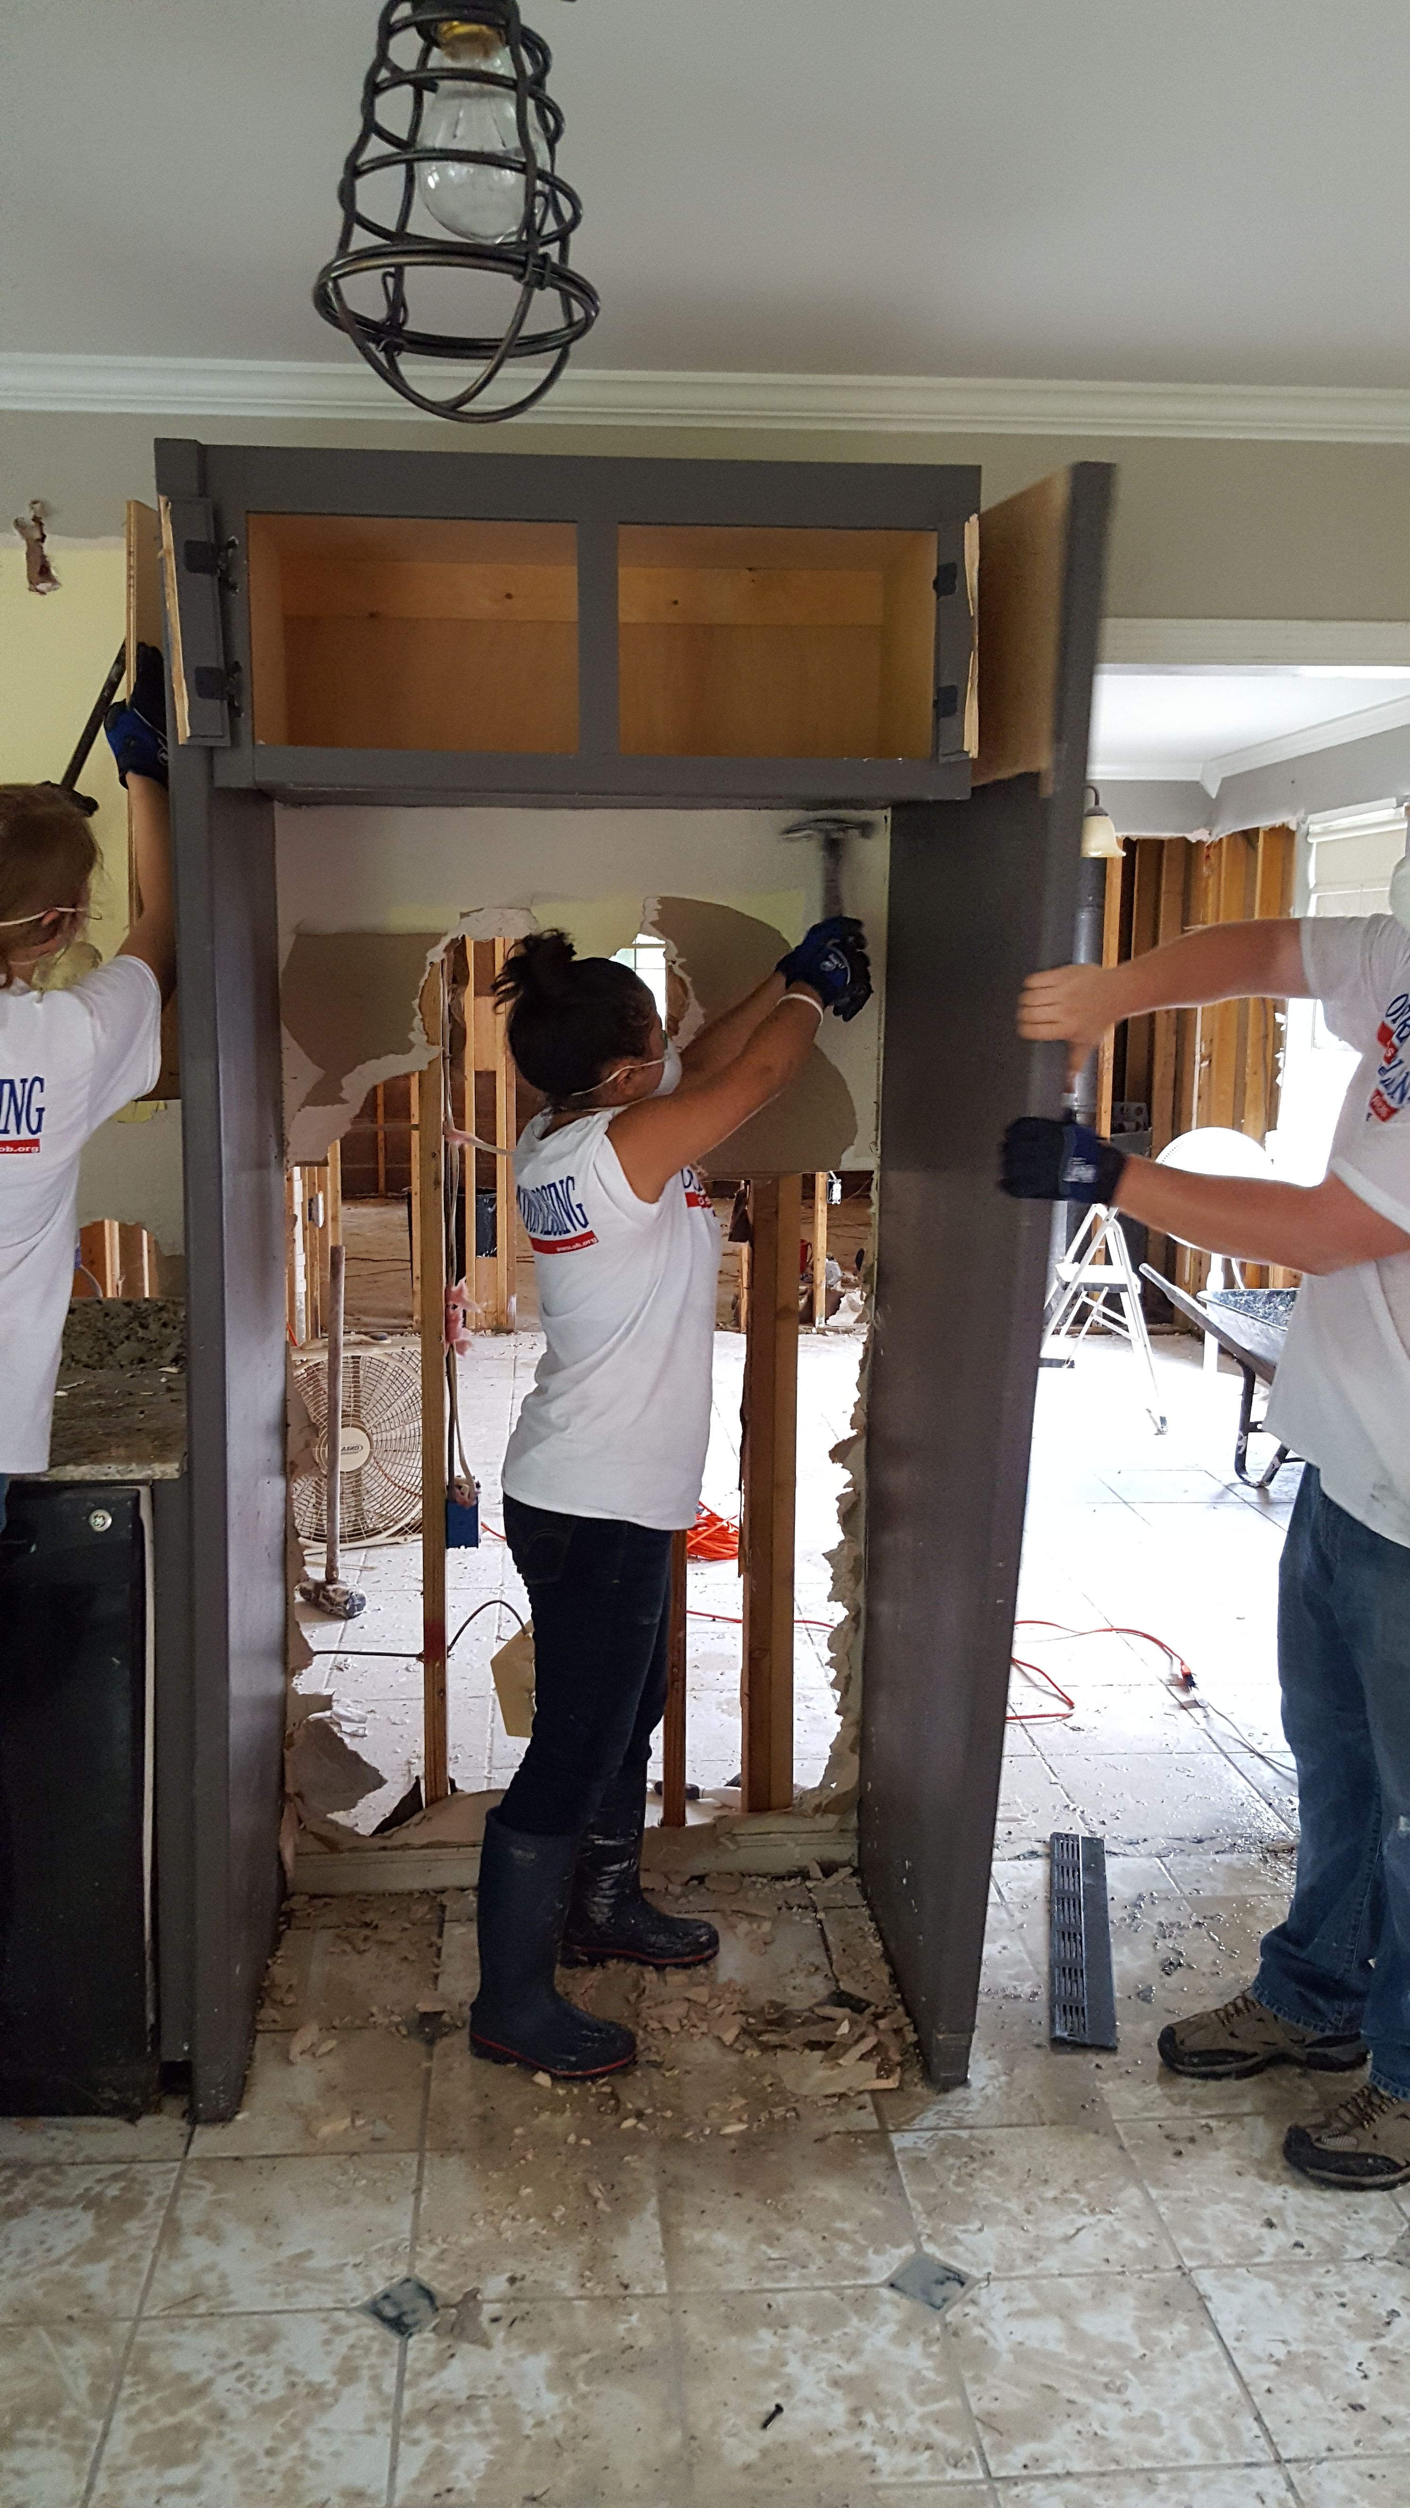

Slide 19
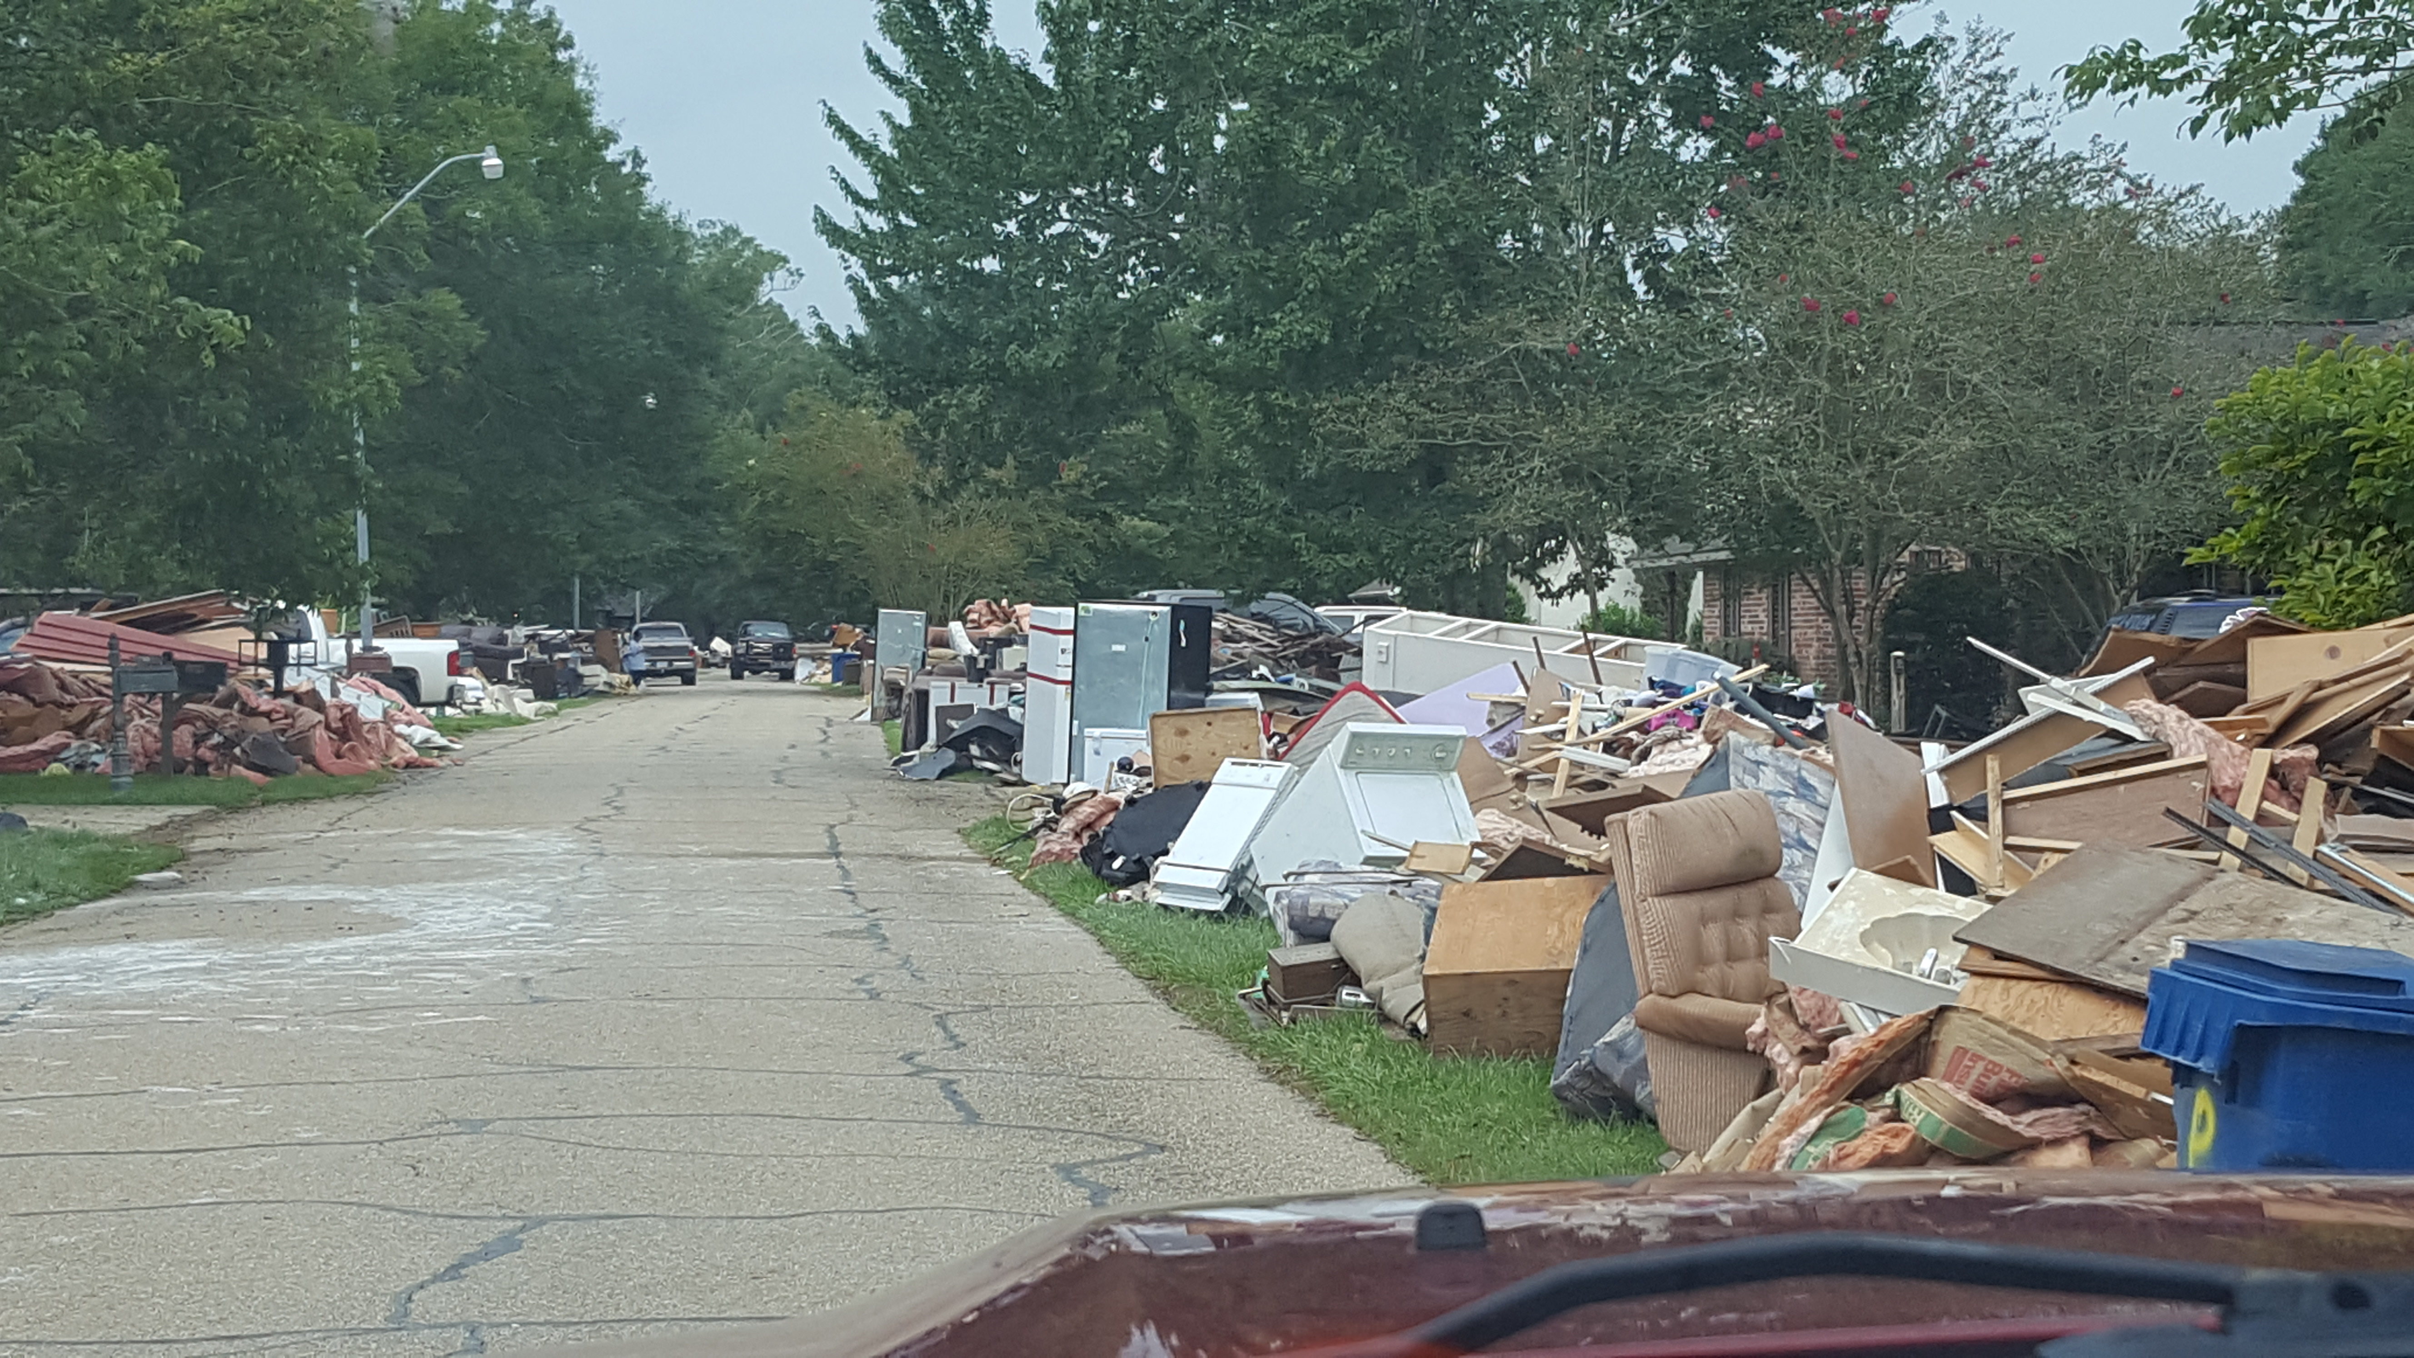

Slide 20
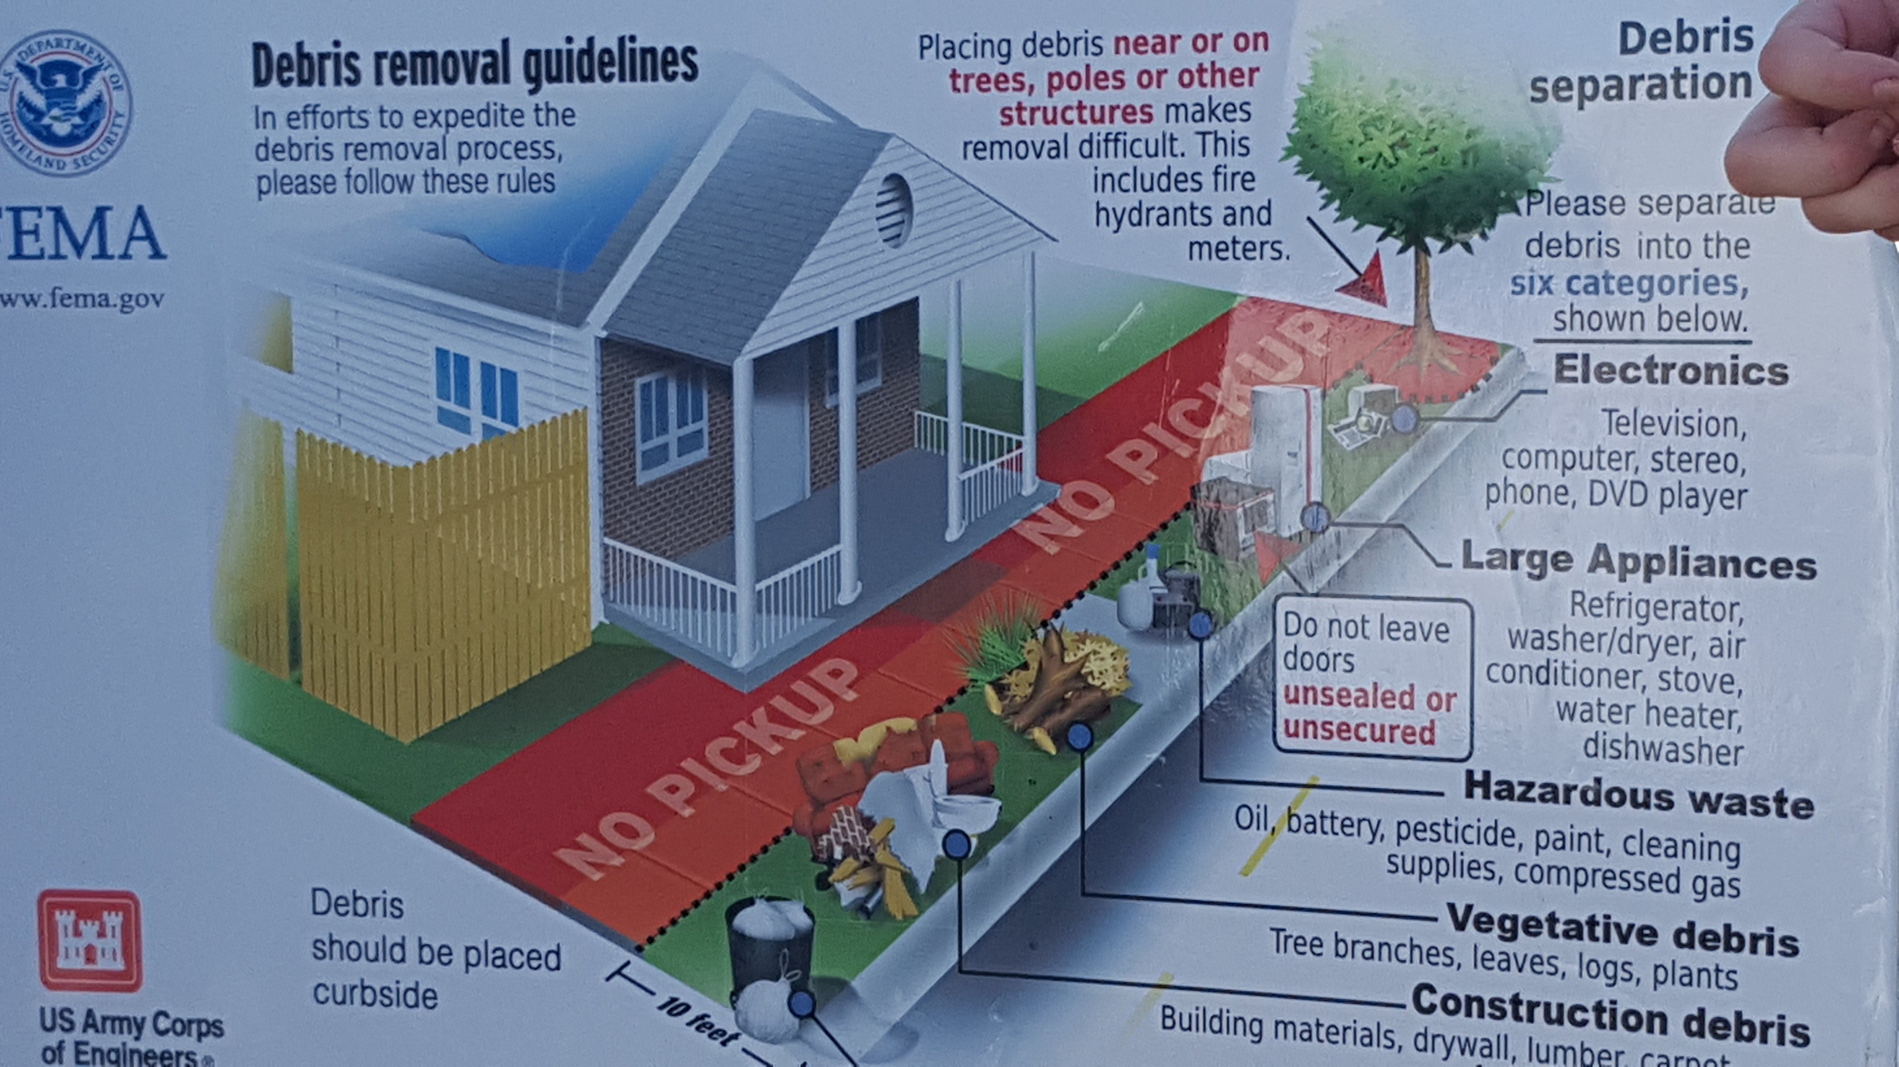

Slide 21
Tarping Crews

Slide 22
Tarping crews

Slide 23
PODS POINTS OF DISTRUBUTION

Slide 24
PODS POINTS OF DISTRIBUTION 1. Free FEMA training online 2. Organizational skills. 3. Inventory Mgmt

Slide 25
Volunteer Management 1. Computer skills 2. People skills 3. Safety Briefing 4. Take Charge and problem solving

Slide 26
FOOD PREPREATION

Slide 27
Rebuilding Phase Team up with NGOs Specializing in Rebuild
SBP
Operation Blessing
Samaritan's Purse.
Church Groups
GEM

Slide 28
Rebuild needs
Construction Materials such as drywall, flooring, wood, roofing etc
Housing
Insurance claims deficiencies
Fema Appeals
Most Vulnerable parts of community will need more long-term needs
Elderly
Disabled VETS
Lower income areas
Special needs Communities

